Slide 1
Neural Networks
Jurafsky and Martin Chapter 7

Slide 2
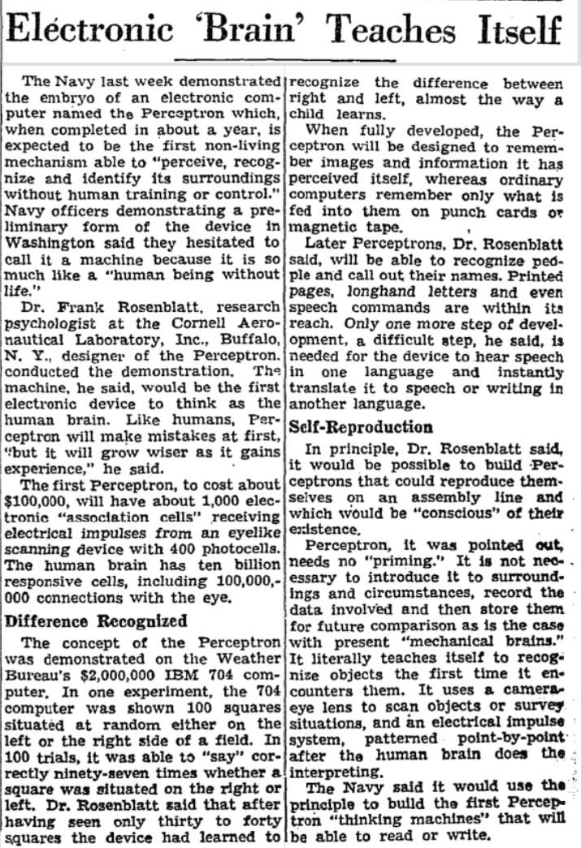
Review: Perceptron
Perceptrons were developed in the 1950s and 1960s loosely inspired by the neuron.
Notes:
New York Times - July 13, 1958 “Electronic 'Brain' Teaches Itself”
The Navy last week demonstrated the embryo of an electronic computer named the Perceptron which, when completed in about a year, is expected to be the first non-living mechanism able to "perceive, recognize and identify its surroundings without human training or control."

Slide 3
Neural Networks
The building block of a neural network is a single computational unit. A unit takes a set of real valued numbers as input, performs some computation.

Slide 4
Neural Networks: A brain-inspired metaphor

Slide 5
A single neuron
Notes:
As the name suggests, neural networks were inspired by the brain’s computation mechanism, which consists of computation units called neurons. While the connections between artificial neural networks and the brain are in fact rather slim, we repeat the metaphor here for complete- ness. In the metaphor, a neuron is a computational unit that has scalar inputs and outputs. Each input has an associated weight. e neuron multiplies each input by its weight, and then sums1 them, applies a nonlinear function to the result, and passes it to its output. Figure 4.1 shows such a neuron.

Slide 6
Neural networks
Notes:
The neurons are connected to each other, forming a network: the output of a neuron may feed into the inputs of one or more neurons. Such networks were shown to be very capable computational devices. If the weights are set correctly, a neural network with enough neurons and a nonlinear activation function can approximate a very wide range of mathematical functions (we will be more precise about this later).
A typical feed-forward neural network may be drawn as shown. Each circle is a neuron, with incoming arrows being the neuron’s inputs and outgoing arrows being the neuron’s outputs. Each arrow carries a weight, reflecting its importance (not shown). Neurons are arranged in layers, reflecting the flow of information. The bottom layer has no incoming arrows, and is
the input to the network. the top-most layer has no outgoing arrows, and is the output of the network. The other layers are considered “hidden.” thee sigmoid shape inside the neurons in the middle layers represent a nonlinear function (i.e., the logistic function) that is applied to the neuron’s value before passing it to the output. In the figure, each neuron is connected to all of the neurons in the next layer—this is called a fully connected layer or an affine layer.

Slide 7
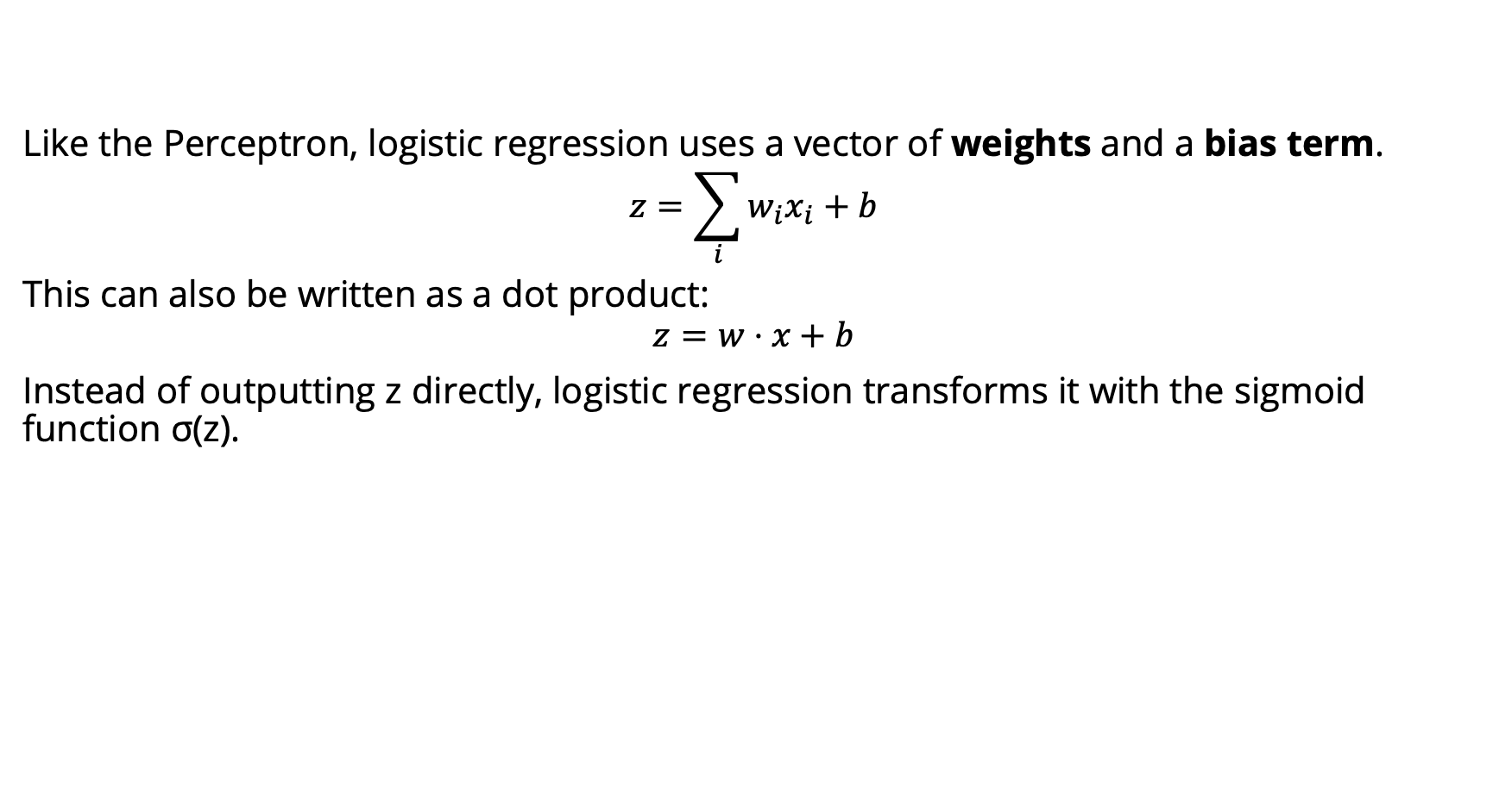
Perceptron -> Logistic Regression
Like the Perceptron, logistic regression uses a vector of weights and a bias term.
$$z=\sum_{i}{w_{i}x_{i}+b}$$
This can also be written as a dot product:
$$z=w⋅x+b$$
Instead of outputting z directly, logistic regression transforms it with the sigmoid function σ(z).

Slide 8
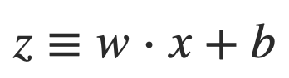
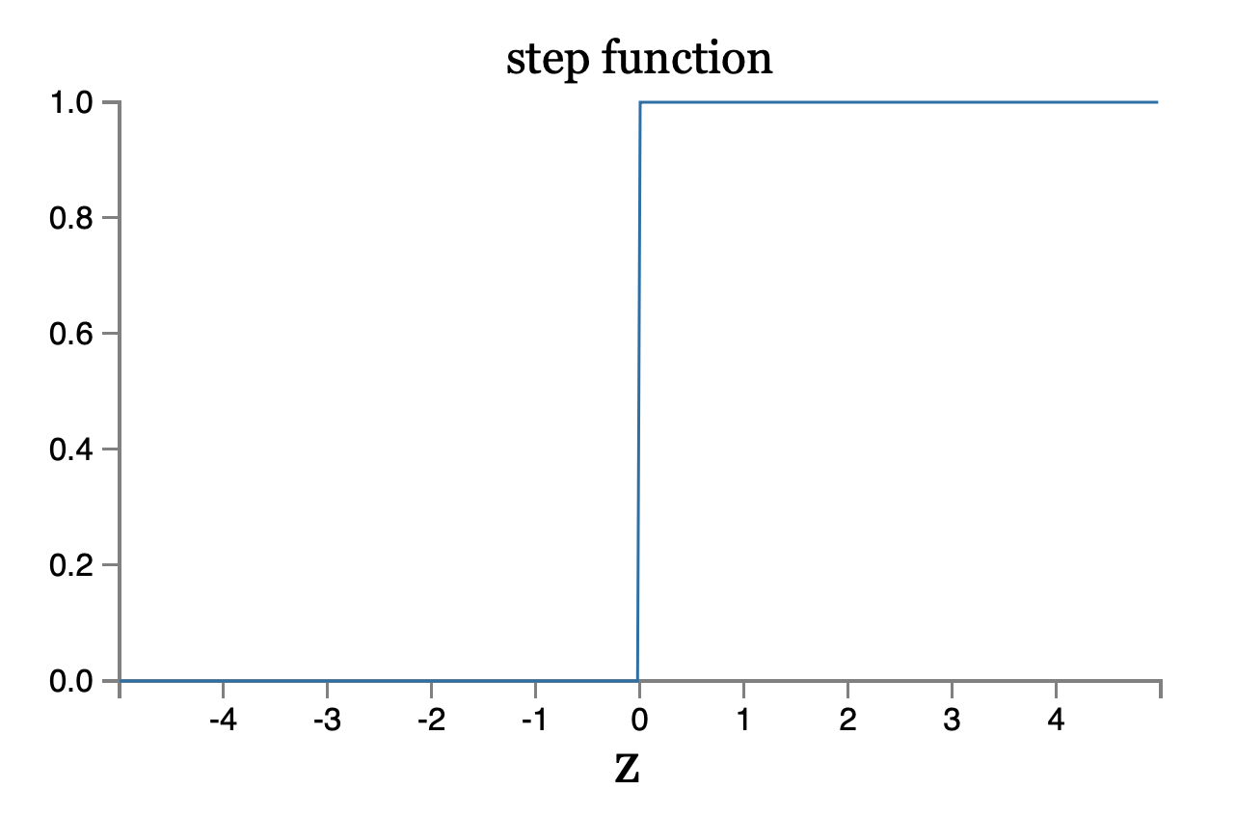
Perceptron

Slide 9
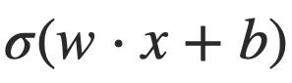
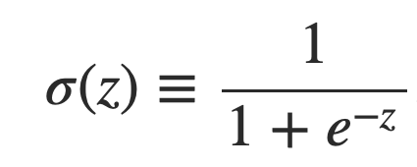
Sigmoid neurons
Problem: a small change in the weights or bias of any single perceptron in the network can causes the output to completely flip from 0 to 1.
Solution: sigmoid neuron
Perceptron
Sigmoid neuron
output =
Output is no longer just 1 or 0.
Same weights and bias as perceptron
Sigmoid function:
Inputs: any real-valued number
Notes:
That flip may then cause the behavior of the whole network to change in a very complicated way.

Slide 10
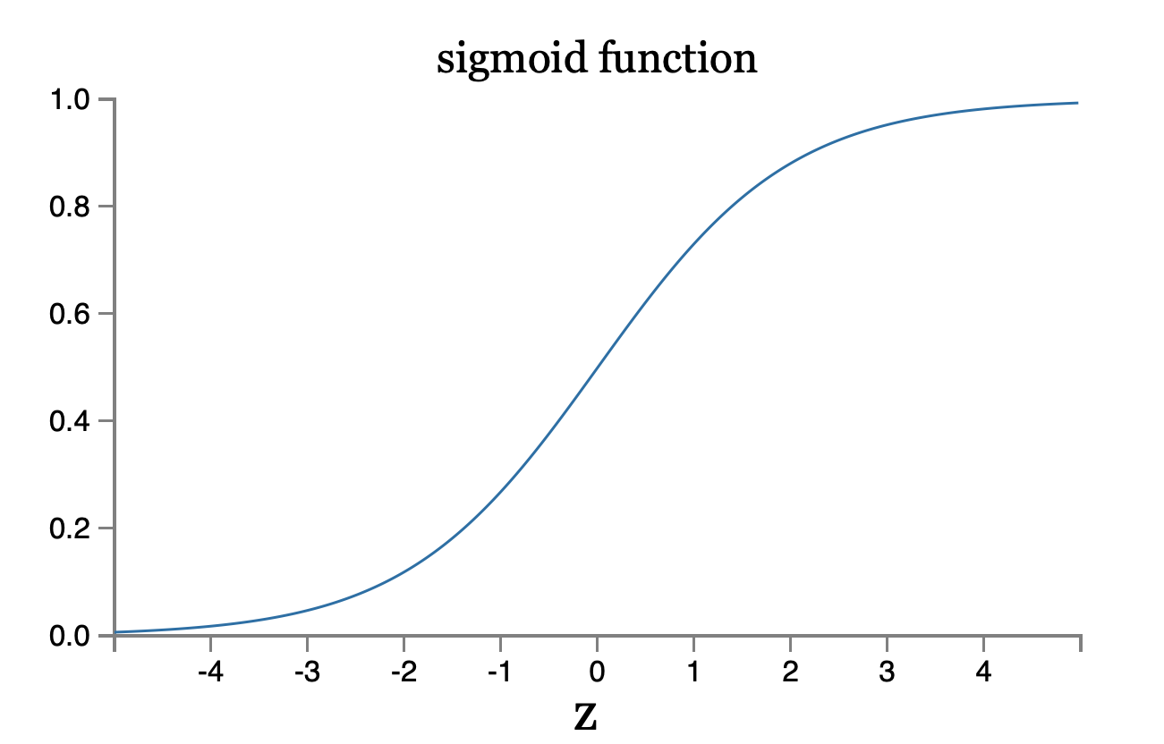
Sigmoid neuron
Notes:
To understand the similarity to the perceptron model, suppose z≡w⋅x+bz≡w⋅x+b is a large positive number. Then e^−z≈00 and so σ(z)≈1. In other words, when z=w⋅x+b is large and positive, the output from the sigmoid neuron is approximately 1, just as it would have been for a perceptron. Suppose on the other hand that z=w⋅x+b is very negative. Then e^−z→∞, and σ(z)≈00. So when z=w⋅x+b is very negative, the behavior of a sigmoid neuron also closely approximates a perceptron. It's only when w⋅x+b is of modest size that there's much deviation from the perceptron model.

Slide 11
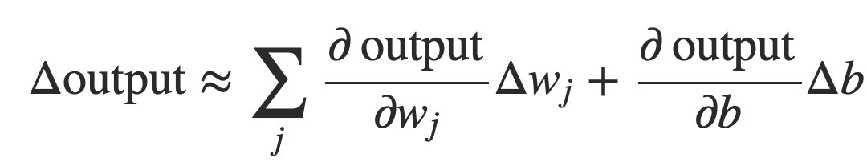
Smoothness is crucial
Smoothness of σ means that small changes in the weights w_{j} and in the bias b will produce a small change the output from the neuron
Δoutput is a linear function of the changes Δwj and Δb
This makes it easy to choose small changes in the weights and biases to achieve any desired small change in the output
Notes:
where the sum is over all the weights, wj and bias b and ∂output/∂wj is the partial derivative of the output with respect to wj. And ∂output/∂b denote partial derivative of the output with respect b.
This linearity makes it easy to choose small changes in the weights and biases to achieve any desired small change in the output. So while sigmoid neurons have much of the same qualitative behaviour as perceptrons, they make it much easier to figure out how changing the weights and biases will change the output.

Slide 12
Activation Functions
Instead of directly outputting z = w·x+b, which is a linear function of x, neuron units apply a non-linear function f to z.
The output of this function is called the activation value for the unit, represented by the variable a. The output of a neural network is called y, so if the activation of a node is the final output of a network then
y=a= f(z)
There are 3 commonly used non-linear functions used for f: The sigmoid function The tanh function The rectified linear unit ReLU
The sigmoid function

Slide 13
Activation Functions
The sigmoid function
tanh
ReLU
Notes:
These activation functions have different properties that make them useful for differ- ent language applications or network architectures. For example the rectifier func- tion has nice properties that result from it being very close to linear. In the sigmoid or tanh functions, very high values of z result in values of y that are saturated, i.e., extremely close to 1, which causes problems for learning. Rectifiers don’t have this problem, since the output of values close to 1 also approaches 1 in a nice gentle linear way. By contrast, the tanh function has the nice properties of being smoothly differentiable and mapping outlier values toward the mean.
In practice, the sigmoid is not commonly used as an activation function.

Slide 14
Feed-Forward Neural Network
The simplest kind of NN is the Feed-Forward Neural Network
Multilayer network, all units are usually fully-connected, and no cycles.
The outputs from each layer are passed to units in the next higher layer, and no outputs are passed back to lower layers.
Layer 2 (output layer)
Layer 1 (hidden layer)
Layer 0 (input layer)
Notes:
We’ll introduce networks with cycles, called recurrent neural networks Later. For historical reasons multilayer networks, especially feedforward networks, are sometimes called multi-layer perceptrons (or MLPs); this is a technical misnomer, since the units in modern multilayer networks aren’t perceptrons (perceptrons are purely linear, but modern networks are made up of units with non-linearities like sigmoids), but at some point the name stuck.
The core of the neural network is the hidden layer formed of hidden units, each of which is a neural unit, taking a weighted sum of its inputs and then applying a non-linearity. In the standard architecture, each layer is fully-connected, meaning that each unit in each layer takes as input the outputs from all the units in the previous layer, and there is a link between every pair of units from two adjacent layers. Thus each hidden unit sums over all the input units.

Slide 15
Equations for a feedforward network
A single hidden unit has parameters w (the weight vector) and b (the bias scalar).
We represent the parameters for the entire hidden layer by combining the weight vector w_{i} and bias b_{i} for each unit i into a single weight matrix W and a single bias vector b for the whole layer.
Notes:
Each element Wi j of the weight matrix W represents the weight of the connection from the ith input unit xi to the jth hidden unit hj.

Slide 16
Equations for a feedforward network
The advantage of using a single matrix W for the weights of the entire layer is the hidden layer computation can be done efficiently with simple matrix operations.
The computation has three steps:
1. multiplying the weight matrix by the input vector x, 2. adding the bias vector b, and 3. applying the activation function g (such as Sigmoid)
The output of the hidden layer, the vector h, is thus the following, using the sigmoid function σ:
h = σ(Wx+b)
Notes:
Notice that we’re applying the σ function here to a vector, while previously it was applied to a scalar. We’re thus allowing σ(·), and indeed any activation function g(·), to apply to a vector element-wise, so g[z1,z2,z3] = [g(z1),g(z2),g(z3)].

Slide 17
Equations for a feedforward network
Like the hidden layer, the output layer has a weight matrix U. Its weight matrix is multiplied by its input vector (h) to produce the intermediate output z.
z=Uh
Notes:
Each element Wi j of the weight matrix W represents the weight of the connection from the ith input unit xi to the jth hidden unit hj.

Slide 18
Equations for a feedforward network
Here are the final equations for a feedforward network with a single hidden layer, which takes an input vector x, outputs a probability distribution y, and is parameterized by weight matrices W and U and a bias vector b:
h = σ(Wx+b) z = Uh y = softmax(z)
Like with logistic regression, softmax normalizes the output and turns it into a probability distribution.
Notes:
Notice that we’re applying the σ function here to a vector, while previously it was applied to a scalar. We’re thus allowing σ(·), and indeed any activation function g(·), to apply to a vector element-wise, so g[z1,z2,z3] = [g(z1),g(z2),g(z3)].

Slide 19
Review: Feed-Forward Neural Network
The simplest kind of is the Feed-Forward Neural Network
Multilayer network, all units are usually fully-connected, and no cycles.
The outputs from each layer are passed to units in the next higher layer, and no outputs are passed back to lower layers.
Layer 2 (output layer)
Layer 1 (hidden layer)
Layer 0 (input layer)
Notes:
We’ll introduce networks with cycles, called recurrent neural networks Later. For historical reasons multilayer networks, especially feedforward networks, are sometimes called multi-layer perceptrons (or MLPs); this is a technical misnomer, since the units in modern multilayer networks aren’t perceptrons (perceptrons are purely linear, but modern networks are made up of units with non-linearities like sigmoids), but at some point the name stuck.
The core of the neural network is the hidden layer formed of hidden units, each of which is a neural unit, taking a weighted sum of its inputs and then applying a non-linearity. In the standard architecture, each layer is fully-connected, meaning that each unit in each layer takes as input the outputs from all the units in the previous layer, and there is a link between every pair of units from two adjacent layers. Thus each hidden unit sums over all the input units.

Slide 20
Review: Feed-Forward Neural Network
A single hidden unit has parameters w (the weight vector) and b (the bias scalar).
We represent the parameters for the entire hidden layer by combining the weight vector w_{i} and bias b_{i} for each unit i into a single weight matrix W and a single bias vector b for the whole layer.
Notes:
Each element Wi j of the weight matrix W represents the weight of the connection from the ith input unit xi to the jth hidden unit hj.

Slide 21
Review: Feed-Forward Neural Network
The advantage of using a single matrix W for the weights of the entire layer is the hidden layer computation can be done efficiently with simple matrix operations.
The computation has three steps:
1. multiplying the weight matrix by the input vector x, 2. adding the bias vector b, and 3. applying the activation function g (such as Sigmoid)
The output of the hidden layer, the vector h, is thus the following, using the sigmoid function σ:
h = σ(Wx+b)
Notes:
Notice that we’re applying the σ function here to a vector, while previously it was applied to a scalar. We’re thus allowing σ(·), and indeed any activation function g(·), to apply to a vector element-wise, so g[z1,z2,z3] = [g(z1),g(z2),g(z3)].

Slide 22
Review: Feed-Forward Neural Network
Like the hidden layer, the output layer has a weight matrix U. Its weight matrix is multiplied by its input vector (h) to produce the intermediate output z.
z=Uh
Notes:
Each element Wi j of the weight matrix W represents the weight of the connection from the ith input unit xi to the jth hidden unit hj.

Slide 23
Review: Feed-Forward Neural Network
Here are the final equations for a feedforward network with a single hidden layer, which takes an input vector x, outputs a probability distribution y, and is parameterized by weight matrices W and U and a bias vector b:
h = σ(Wx+b) z = Uh y = softmax(z)
Like with logistic regression, softmax normalizes the output and turns it into a probability distribution.
Notes:
Notice that we’re applying the σ function here to a vector, while previously it was applied to a scalar. We’re thus allowing σ(·), and indeed any activation function g(·), to apply to a vector element-wise, so g[z1,z2,z3] = [g(z1),g(z2),g(z3)].

Slide 24
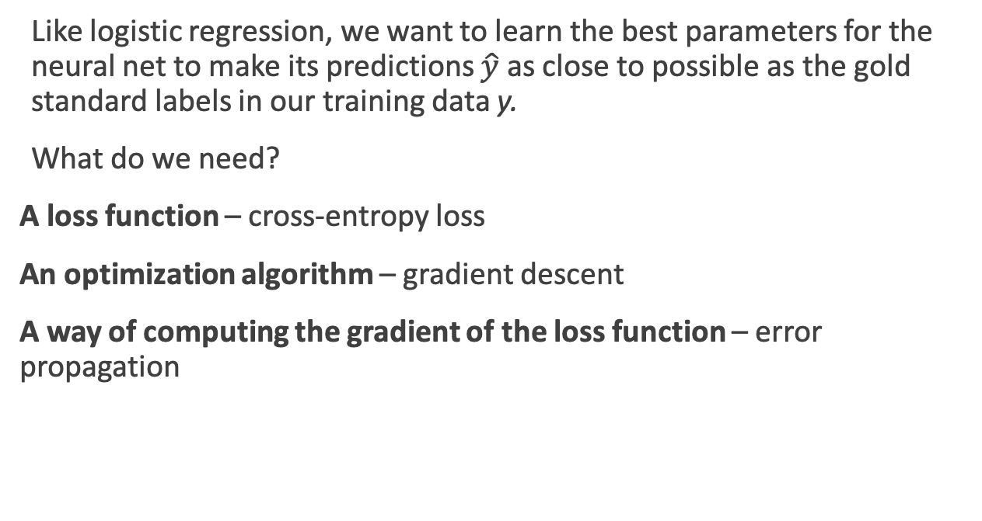
Training Neural Nets
Like logistic regression, we want to learn the best parameters for the neural net to make its predictions $\hat{y}$ as close to possible as the gold standard labels in our training data y.
What do we need?
A loss function – cross-entropy loss
An optimization algorithm – gradient descent
A way of computing the gradient of the loss function – error propagation
Notes:
gradient descent requires knowing the gradient of the loss function, the vector that contains the partial derivative of the loss function with respect to each of the parameters. Here is one part where learning for neural networks is more complex than for logistic logistic regression. In logistic regression, for each observation we could directly compute the derivative of the loss function with respect to an individual w or b. But for neural networks, with millions of parameters in many layers, it’s much harder to see how to compute the partial derivative of some weight in layer 1 when the loss is attached to some much later layer. How do we partial out the loss over all those intermediate layers?
The answer is the algorithm called error backpropagation or reverse differentiation.

Slide 25
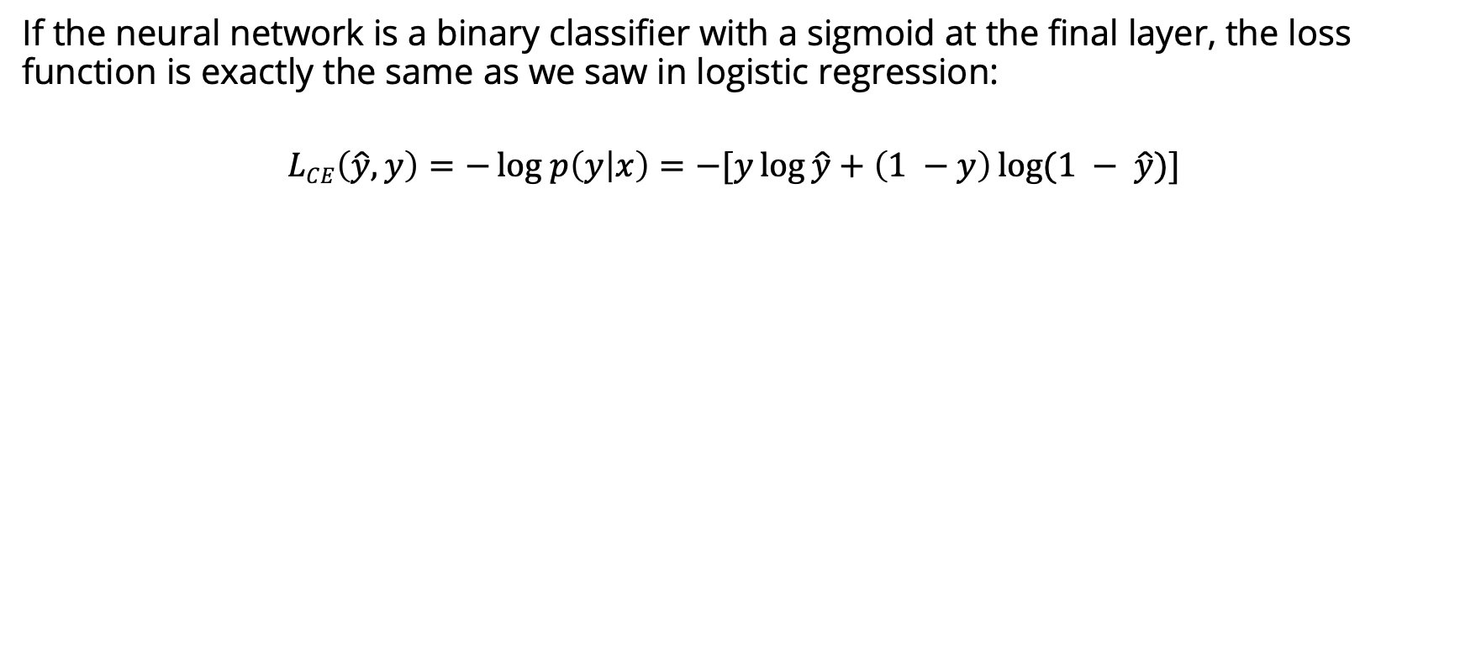
Cross-Entropy Loss
If the neural network is a binary classifier with a sigmoid at the final layer, the loss function is exactly the same as we saw in logistic regression:
$$LCE\left(\hat{y}, y\right)=−log p\left(y | x\right){=−[y\log{\hat{y}+\left(1 −y\right)\log{(1 − \hat{y}})]}}$$
Notes:
K in the denominator is the number of classes.

Slide 26
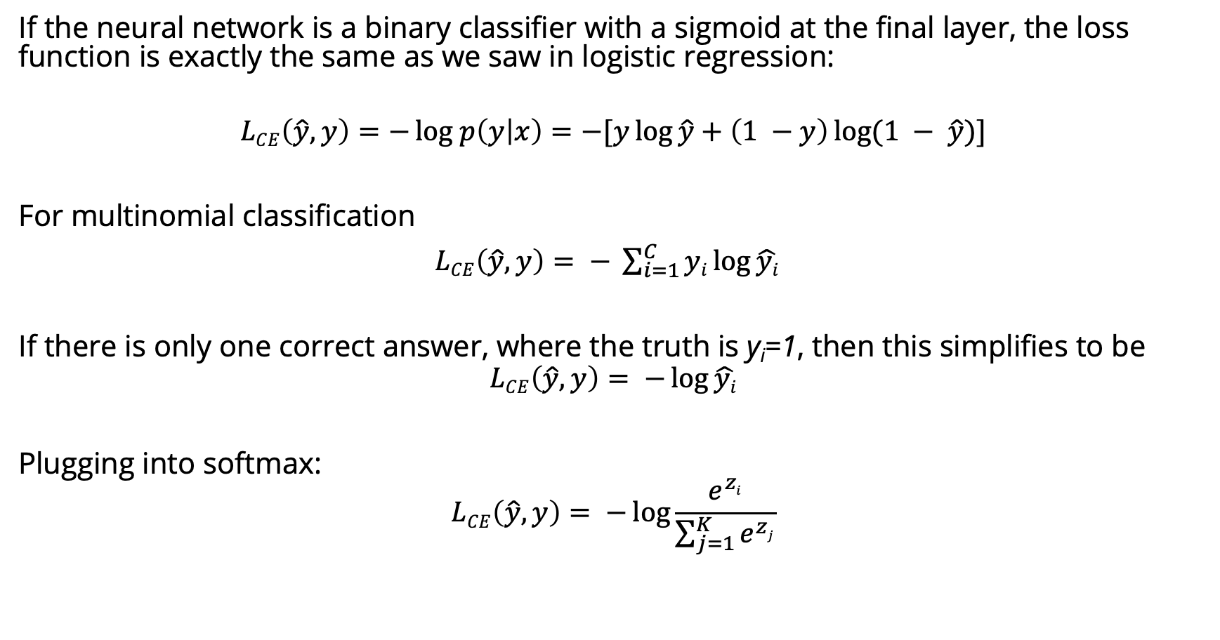
Cross-Entropy Loss
If the neural network is a binary classifier with a sigmoid at the final layer, the loss function is exactly the same as we saw in logistic regression:
$$LCE\left(\hat{y}, y\right)=−log p\left(y | x\right){=−[y\log{\hat{y}+\left(1 −y\right)\log{(1 − \hat{y}})]}}$$
For multinomial classification
$LCE\left(\hat{y}, y\right)= − \sum_{i=1}^{C}{yi\log{\hat{yi}} }$
If there is only one correct answer, where the truth is y_{i}=1, then this simplifies to be
$$LCE\left(\hat{y}, y\right)= −\log{\hat{yi}}$$
Plugging into softmax:
$$LCE\left(\hat{y}, y\right)= −\log{\frac{e^{zi}}{\sum_{j=1}^{K}{e^{zj}}}}$$
Notes:
K in the denominator is the number of classes.

Slide 27
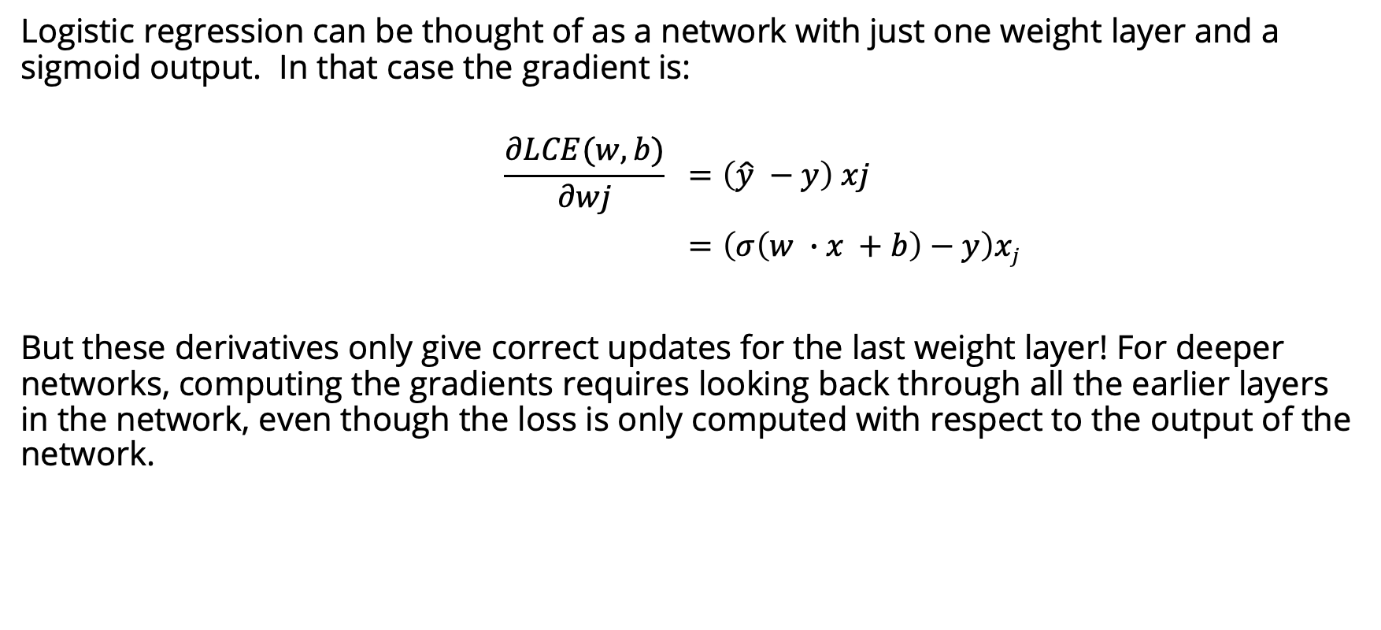
Computing the gradient
Logistic regression can be thought of as a network with just one weight layer and a sigmoid output. In that case the gradient is:
$$\frac{∂LCE(w,b)}{∂wj} =\left(\hat{y} −y\right) xj$$
$=\left(σ\left(w ∙x +b\right)−y\right)xj$
But these derivatives only give correct updates for the last weight layer! For deeper networks, computing the gradients requires looking back through all the earlier layers in the network, even though the loss is only computed with respect to the output of the network.
Solution: error backpropagation algorithm

Slide 28
Computation Graphs
Although backpropagation was invented for neural nets, it is related to general procedure called backward differentiation, which depends on the notion of computation graphs.
A computation graph represents the process of computing a mathematical expression. The computation is broken down into separate operations. Each operation is a node in a graph.
L(a, b, c) = c(a + 2b)
d = 2∗b
e = a+d
L = c∗e
Notes:
If we make each of the component addition and multiplication operations explicit, and add names (d and e) for the intermediate outputs, the resulting series of computations is as shown on the righ.

Slide 29
Forward pass
L(a, b, c) = c(a + 2b)
d = 2∗b
e = a+d
L = c∗e
inputs a = 3, b = 1, c = −2,
Notes:
We can now represent this as a graph, with nodes for each operation, and directed edges showing the outputs from each operation as the inputs to the next, The simplest use of computation graphs is to compute the value of the function with some given inputs. For inputs a = 3, b = 1, c = −2, and we’ve shown the result of the forward pass to compute the result L(3, 1, −2) = 10. In the forward pass of a computation graph, we apply each operation left to right, passing the outputs of each computation as the input to the next node.

Slide 30
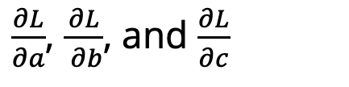
Backward differentiation
The importance of the computation graph comes from the backward pass, which is used to compute the derivatives that we’ll need for the weight update.
How do we compute the derivative of our output function L with respect to the input variables a, b, and c?
Backwards differentiation uses the chain rule from calculus.
$\frac{∂L}{∂a}$, $\frac{∂L}{ ∂b}$, and $\frac{∂L}{∂c}$
Notes:
The importance of the computation graph comes from the backward pass, which is used to compute the derivatives that we’ll need for the weight update. In this example our goal is to compute the derivative of the output function L with respect to each of the input variables, i.e., ∂L/∂a ∂L/∂b , and
∂L/∂c .
The derivative ∂L/∂a , tells us how much a small change in a affects L.

Slide 31
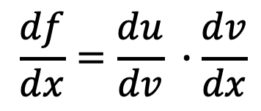
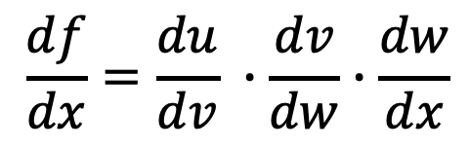
Chain rule
For a composite function f(x) = u(v(x)), the derivative of f(x) is:
Similarly for, f(x) = u(v(w(x))), the derivative of f(x) is:
$$\frac{df}{dx}=\frac{du}{dv} ∙\frac{dv}{dx}$$
$$\frac{df}{dx}=\frac{du}{dv} ∙\frac{dv}{dw}∙\frac{dw}{dx}$$
Notes:
Suppose we are computing the derivative of a composite function f (x) = u(v(x)). The derivative of f (x) is the derivative of u(x) with respect to v(x) times the derivative of v(x) with respect to x.

Slide 32
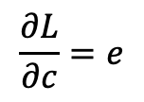
$$\frac{∂L}{∂c}=e$$
Notes:
Let’s now compute the 3 derivatives we need. Since in the computation graph L = ce, we can directly compute the derivative ∂L/∂c For the other two, we’ll need to use the chain rule. thus requires five intermediate derivatives. the derivative of a sum is the sum of the derivatives.

Slide 33
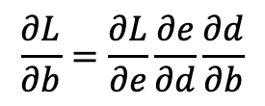
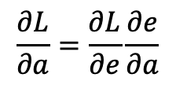
$$\frac{∂L}{∂a}=\frac{∂L}{∂e}\frac{∂e}{∂a}$$
$$\frac{∂L}{∂b}=\frac{∂L}{∂e}\frac{∂e}{∂d}\frac{∂d}{∂b}$$
$$\frac{∂L}{∂c}=e$$
Notes:
Let’s now compute the 3 derivatives we need. Since in the computation graph L = ce, we can directly compute the derivative ∂L/∂c For the other two, we’ll need to use the chain rule. thus requires five intermediate derivatives. the derivative of a sum is the sum of the derivatives.

Slide 34
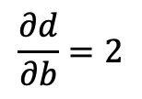
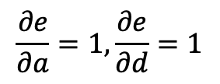
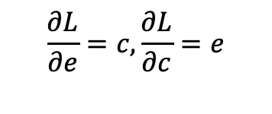
$$\frac{∂L}{∂a}=\frac{∂L}{∂e}\frac{∂e}{∂a}$$
$$\frac{∂e}{∂a}=1,\frac{∂e}{∂d}=1$$
$$\frac{∂L}{∂b}=\frac{∂L}{∂e}\frac{∂e}{∂d}\frac{∂d}{∂b}$$
$$\frac{∂d}{∂b}=2$$
$$\frac{∂L}{∂e}=c, \frac{∂L}{∂c}=e$$
$$\frac{∂L}{∂c}=e$$
Notes:
Let’s now compute the 3 derivatives we need. Since in the computation graph L = ce, we can directly compute the derivative ∂L/∂c For the other two, we’ll need to use the chain rule. thus requires five intermediate derivatives. the derivative of a sum is the sum of the derivatives.

Slide 35
Backward pass
Notes:
In the backward pass, we compute each of these partials along each edge of the graph from right to left, multiplying the necessary partials to result in the final derivative we need. Thus we begin by annotating the final node with ∂ L /∂ L = 1. Moving to the ∂L left, we then compute ∂ L/∂ c and ∂ L/∂ e , and so on, until we have annotated the graph all the way to the input variables. The forward pass conveniently already will have computed the values of the forward intermediate variables we need (like d and e) to compute these derivatives. In this figure, At each node we need to compute the local partial derivative with respect to the parent, multiply it by the partial derivative that is being passed down from the parent, and then pass it to the child.

Slide 36
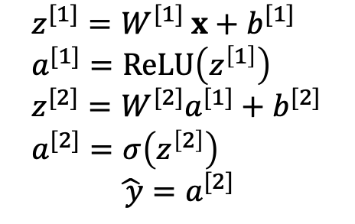
Computation Graph for a NN
$$z^{[1]}=W^{[1]} x+b^{[1]} \\ a^{[1]}=ReLU\left(z^{\left[1\right]}\right) \\ z^{[2]}=W^{[2]}a^{[1]}+b^{[2]} \\ a^{[2]}=σ\left(z^{\left[2\right]}\right)$$
$\hat{ y}=$ $a^{[2]}$
Notes:
This shows a sample computation graph for a 2-layer neural network with layers of sizen0 = 2, n1 = 2, and n2 = 1. Assuming binary classification and hence using a sigmoid output unit for simplicity. The function that the computation graph is computing is: given by these equations in the lower right.
he weights that need updating (those for which we need to know the partial derivative of the loss function) are shown in orange. In order to do the backward pass, we’ll need to know the derivatives of all the functions in the graph. The derivative of the sigmoid σ :
dσ(z)/dz = σ(z)(1−σ(z))

